Slide 1
Recursive resolution
A recursive query is a kind of query, in which the DNS server, who received your query will
do all the job of fetching the answer, and giving it back to you. During this process, the DNS
server might also query other DNS server's in the internet on your behalf, for the answer.

Slide 2
Iterative resolution
client sends query to 1st server if server is authorized to
domain name it sends answer otherwise send IP address of next
server who can resolve query. Now here client sends query to 2nd
server .Client continues this process of sending query to server until
query is resolved.
In recursive client only send query to 1st server then server will send request to next server until query is resolved.
In iterative client is responsible for sending query to different servers until query is resolved.

Slide 3
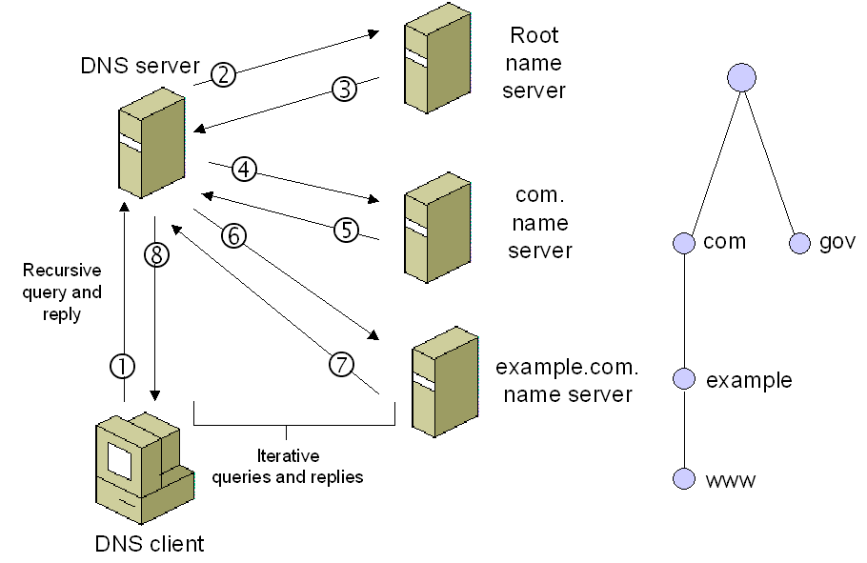
DNS server which keeps all root zone is called TLD name server.

Slide 4


A root server
Located in Amsterdam, , the Netherlands
198.41.0.4 – IPV4
2001:503:ba3e::2:30 – IPV6
B root server
Located in Budapest, Hungary
199.9.14.201 – IPV4
2001:500:200::b – IPV6

Slide 5


C root server
Located in Paris, France
192.33.4.12 – IPV4
2001:500:2::c – IPV6
D root server
Located in London, United Kingdom
199.7.91.13 – IPV4
2001:500:2d::d – IPV6

Slide 6


E root server
Located at Boston, US
192.203.230.10 – IPV4
2001:500:a8::e – IPV6
F root server
Located at Melbourne, Victoria, Australia
192.5.5.241 – IPV4
2001:500:2f::f – IPV6

Slide 7
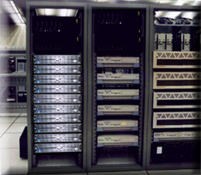

G root server
Located at Chicago, Illinois, USA
192.112.36.4 – IPV4
2001:500:12::d0d – IPV6
H root server
Located at Des Moines, Iowa, USA
198.97.190.53 – IPV4
2001:500:1::53 – IPV6

Slide 8


I root server
Located at Chennai, Tamilnadu, India
192.36.148.17 – IPV4
2001:7fe::53 – IPV6
J root server
Located at Singapore
192.58.128.30 – IPV4
2001:503:c27::2:30 – IPV6

Slide 9

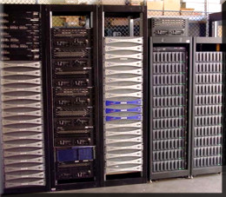
K root server
Located at Moscow, Russia
193.0.14.129 – IPV4
2001:7fd::1 – IPV6
L root server
Located at Tehran, Iran
199.7.83.42 – IPV4
2001:500:9f::42 – IPV6

Slide 10
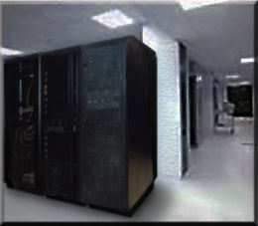
M root server
Located at Chimbote, Peru
202.12.27.33 – IPV4
2001:dc3::35 – IPV6

Slide 11
Working of DNS
Website Request
Ask resolver
Ask root server
Ask TLD server
Ask authoritative name servers
Cache the IP and return it to the browser

